Slide 1
Component Lifecycle

Slide 2
Component Lifecycle
The life cycle methods are provided by the ComponentBase class, which all components inherit from. Each method has a synchronous and asynchronous version. The synchronous version is always called before the asynchronous version.

Slide 3
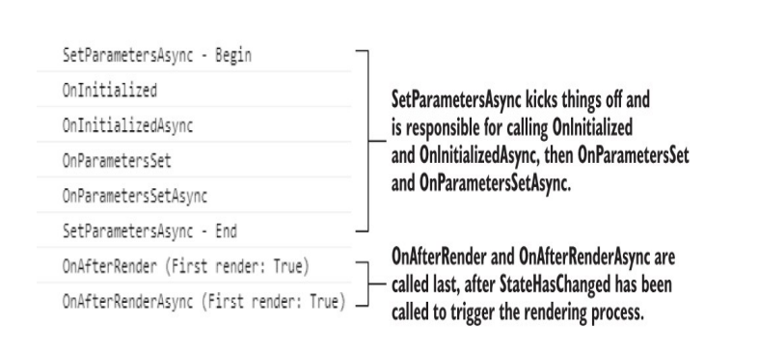
Component Lifecycle

Slide 4
The first render
During the first render, all the component’s life cycle methods will be called. During subsequent renders, only a subset of the methods will run. The process starts with SetParametersAsync being called. This is the only life cycle method that requires us to call the base method; if we don’t, then the component will fail to load. This is because the base method does two essential things:
Sets the values for any parameters the component defines—This happens both the first time the component is rendered and whenever parameters could have changed.
Calls the correct life cycle methods—This depends on whether the component is running for the first time or not. If we removed the call to the base method, the output in the browser console would look like this:
NB: SetParametersAsync is not a life cycle method that is often used by developers. Commonly, it is just OnInitialized, OnParametersSet, and OnAfterRender. In advanced scenarios, you may choose to override SetParametersAsync and not call the base method of SetParametersAsync. Doing so would allow complete control over the component’s initialization and subsequent updates. This can be a useful tool when creating highly performant components; however, that is out of scope for this book.

Slide 5
During a first render, the component hasn’t been initialized. This means that On-Initialized and OnInitializedAsync will be called first—it is also the only time they will run. This pair of methods is the only one that runs once in a component’s lifetime. You can think of these as constructors for your component. It makes them a great place to make API calls—for example, to get the initial data the component will display.
Once the OnInitialized methods have run, OnParametersSet and On-ParametersSetAsync are called. These methods allow developers to perform actions whenever a component’s parameters change. In the case of a first render, the component’s parameters have been set to their initial values.
The final methods to run are OnAfterRender and OnAfterRenderAsync. These methods both take a Boolean value indicating if this is the first time the component has been rendered. On the initial render, the value of firstRender will be set to true; for every render after, it will be false
The primary use of the OnAfterRender methods is to perform JavaScript interop (chapter 8) and other DOM-related operations, such as setting the focus on an element

Slide 6
The life cycle with async
One key point about the render we just covered is that it ran synchronously. In the Lifecycle component, there are no awaited calls in any of the async life cycle methods, meaning each method ran in sequence. However, when async calls are added, then things look a bit different.

Slide 7
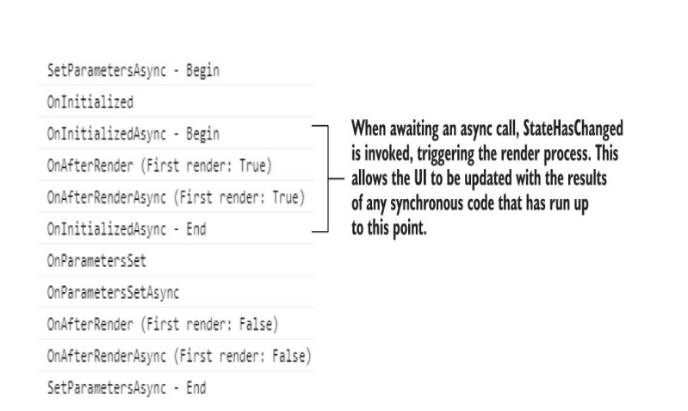

Slide 8
Well, that’s a bit different! While Blazor was awaiting the async call, the component was rendered. It was then rendered a second time after the OnParametersSet methods, as before. This is because Blazor checks to see if an awaitable task is returned from OnInitializedAsync. If there is, it calls StateHasChanged to render the component with the results of any of the synchronous code that has been run so far, while awaiting the completion of the task. This behavior is also true for async calls made in OnParametersSetAsync.

Slide 9
Dispose: The extra life cycle method
There is another life cycle method that we can use, but this one is optional and it’s not built in to the ComponentBase class: Dispose. This method is used for the same purposes in Blazor as in other C# applications: to clean up resources.
This method is essential when creating components that subscribe to events, as failing to unsubscribe from events before a component is destroyed will cause a memory leak. In order to access this method, a component must implement the IDisposable interface. To do this, we can use the @implements directive, shown in the following listing
Blazor understands the IDisposable interface. When it detects its presence on a component, it will call the Dispose method at the correct point when destroying the component instance. Since .NET 5, Blazor also supports the IAsyncDisposable interface. This allows disposal of resources asynchronously, which is useful when using JavaScript interop. But for now, note that IDisposable and IAsyncDisposable can’t both be implemented on the same component. If both are implemented, then only the async version will run

Slide 10
